Slide 1
Voxel Continues Bi-clusters (ConBics) Evaluation
Work in progress…

Slide 2
Background
Study the functional networking in the brain
During task or at rest
Task: regression against task paradigm
Rest: Seed based (anatomically selected) OR data driven clustering (ICA, PCA, k-means , hierarchical , fuzzy).
Temporal dynamics rarely considered

Slide 3
Independent Component Analysis (ICA)
Method for revealing hidden factors that underlie sets of random variables, measurements, or signals.
Very commonly used in neuroscience (for EEG and fMRI). E.g. Esposito F, Goebel R. Curr Opin Neurol. 2011 (Review).
Assumes mutual statistical independence of the non-Gaussian source signals
Different independence definitions yield different ICA algorithms. Usually:
1) Minimization of Mutual Information 2) Maximization of non-Gaussianity
Notes:
is a computational method for separating a multivariate signal into additive subcomponents supposing the mutual statistical independence of the non-Gaussian source signals.

Slide 4
The simple “Cocktail Party” Problem
Mixing matrix A
s₁
x₁
Observations
Sources
x₂
s₂
x = As
n sources, m=n observations

Slide 5
Classical ICA estimation
Observing signals
Original source signal
ICA
0.10
0.05
V4
0.00
-0.05
-0.10
0
50
100
150
200
250

Slide 6
Mathematical definition from A.Hyvarinen, A.Karhunen, E.Oja ‘Independent Component Analysis’
Given a set of observations:
x₁(t), x₂(t)…x_{n}(t) (t is the time or sample index)
We assume that they are generated as a linear mixture of independent components:
y=Wx
Independent component analysis now consists of estimating both the matrix W and y_{i}(t)

Slide 7
ICA stages
Preprocessing stage:
- centering (subtracting the mean)
- “Whitening” the data (de-correlation) done by EVD (Eigen value decomposition)
x~ = (ED^{-1/2}E^{T})x = ED^{-1/2}E^{T} Ax = A~s
where E{xx~} = EDE^{T}
Orthonormal Matrix A~
An orthonormal matrix has n(n-1)/2 degrees of freedom. So for large dim A we have to est only half as much parameters. This greatly simplifies ICA.
Reducing dim of data (choosing dominant Eig) while doing whitening also helps.
Notes:
We transform the x’s linearly so that the x~ are white. Its done by EVD.
x~ = (ED^{-1/2}E^{T})x = ED^{-1/2}E^{T} Ax = A~s
where E{xx~} = EDE^{T}
So we have to Estimate Orthonormal Matrix A~
An orthonormal matrix has n(n-1)/2 degrees of freedom. So for large dim A we have to est only half as much parameters. This greatly simplifies ICA.
Reducing dim of data (choosing dominant Eig) while doing whitening also help.

Slide 8
Computing the rotation step
Aapo Hyvarinen (97)
This is based on an the maximisation of an objective function G(.) which contains an approximate non-Gaussianity measure.
Fixed Point Algorithm
Input: X
Random init of W
Iterate until convergence:
Output: W, S
where g(.) is derivative of G(.), W is the rotation transform sought Λ is Lagrange multiplier to enforce that W is an orthogonal transform i.e. a rotation
Solve by fixed point iterations
The effect of Λ is an orthogonal de-correlation
The overall transform then to take X back to S is (W^{T}V)
There are several g(.) options, each will work best in special cases. See FastICA sw / tut for details.

Slide 9
ICA pros
Completely data driven
Does not require bandpass filter
Dose not require a mask

Slide 10
ICA cons.
Simple ICA does not provide any statistical significance of the components
For the physiologically relevant components one must go fishing (e.g. use anatomic templates)
Requires large number of observations (TRs)
The objective function is dependent on the finite amount of observed data and is potentially non-convex. Hence, each run may potentially yield different ICs for the same data.
* Recent improvements:
- RAICAR, ICASSO allows for the selection of only those ICs that have a high run-to-run reproducibility
- CanICA (canonical ICA) – uses a group of subjects to improve robustness (provides one result for all subjects)

Slide 11
Our approach for data driven network detection (“Local clustering”)
Assumes that voxels operate in local clusters (spatial consecuitivity)
Selects seeds (starting points) from the data (uses farthest point heuristic)
Grows a region around each seed
Merges regions according to signal correlation of all voxels pairs
Currently uses hierarchical clustering + splitting according to distance threshold (ideas are welcome…..)

Slide 12
Some assumptions that we make
Only relevant band frequencies are considered
Only gray matter voxels are considered
We assume local interactions take place

Slide 13
Comparison on one dataset (5 min rest)
Method | # groups | #voxels | Mean pairwise cor | Seperation | % linked voxels | Clustering coefficient
ICA t=4.5 (Informax) | 36 | 8-548 (257) | 0.05-0.54 (0.216) |  | 75-100 (96.5) | 0.017-0.18 (0.04)
ICA t=4.5 (Informax, ICASSO 20 ) | 36 | 64-536 (267) | 0.02-0.54 (0.23) |  | 86-100 (96.86) | 0.017-0.129 (0.042)
Con Clust (0.8,0.2) | 30 | 30-3519 (449) | 0.58-0.752 (0.645) |  | 100 | 0.003-0.32 (0.116)
Con Clust (0.8,0.3) | 17 | 35-4795 (702) | 0.5-0.75 (0.59) |  | 100 | 0.002-0.189 (0.076)
Click | 20 | 191-11201 ( | 0.634-0.721 (0.7) | 0.15 | 67-99 (84.23) | 0.0004-0.02 (0.011)
* ICA currently performed using GroupICAT v2.0e
Notes:
We use prior knowledge: gray matter mask, spatial structure
'ICASSO'. When you select 'ICASSO', ICA is run several times and the best estimate for each component is used.

Slide 14
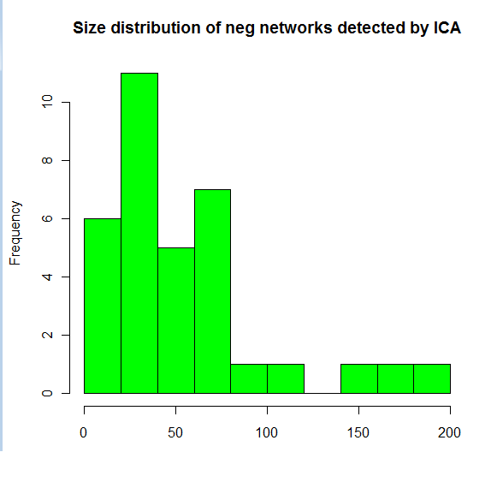
ICA result sizes
Positive contribution to components
Negative contribution to components

Slide 15
Why do we want to look at temporal dynamics?
Growing evidence for different connectivity patterns at different time points
Long term relationships…
Are assumed to represent structural connectivity
So what is short term connectivity? Maybe it is just noise or random correlations?

Slide 16
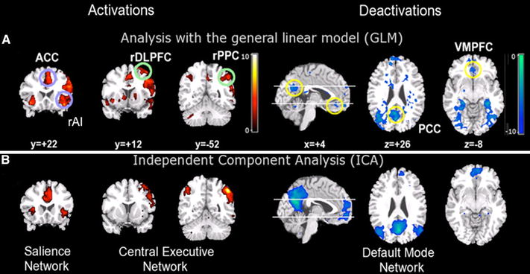
Example: the triple core network model
Menon & Uddin 2010
Notes:
Three major brain networks identified during cognition. Activations in the central executive and salience networks and deactivations in the default mode network during auditory event segmentation. a Analysis with the general linear model revealed regional activations (left) in the right AI and ACC (blue circles); DLPFC and PPC (green circles) and deactivations (right) in the VMPFC and PCC. b Independent component analysis provided converging evidence for spatially distinct networks. From left to right: salience network (rAI and ACC), central executive network (rDLPFC and rPPC), and default mode network (VMPFC and PCC) (adapted from Sridharan et al. 2008)

Slide 17
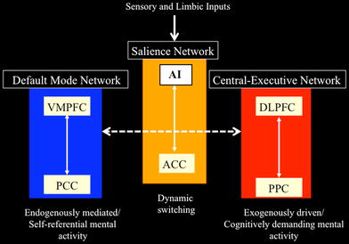
The triple core network model – cont.
The salience network initiates dynamic switching between the CEN and DMN according to salient events. This is done to regulate behavior and maintain homeostasis.
Notes:
Network model of anterior insula function. The anterior insula is part of a salience network, which serves to initiate dynamic switching between the central executive and default mode networks. In our model, sensory and limbic inputs are processed by the anterior insula (AI), which detects salient events and initiates appropriate control signals to regulate behavior and homeostatic state (adapted from Uddin and Menon 2009)

Slide 18
Existing approaches for temporal dynamics
Sliding window
E.g. track changes in cohesion of predefined network/s over time (performed in Talma’s lab)
Variable parameter regression (e.g. using Kalman Filter) - data driven: tries to predict the pattern at time point t according to the previous patterns

Slide 19
ConBic approach
Combines sliding window and local clustering
As in local clustering regions are grown in each time window.
Performs a 2D merge according to signal correlation of all pairs
Currently uses hierarchical clustering + splitting according to distance threshold (ideas are welcome…..)

Slide 20
Can a bic tell us anything new?
Region growing threshold | Clustering split threshols | Resulting bics | Cor delta>0.3
0.8 | 0.2 | 790 | 18
0.8 | 0.3 | 553 | 4

Slide 21
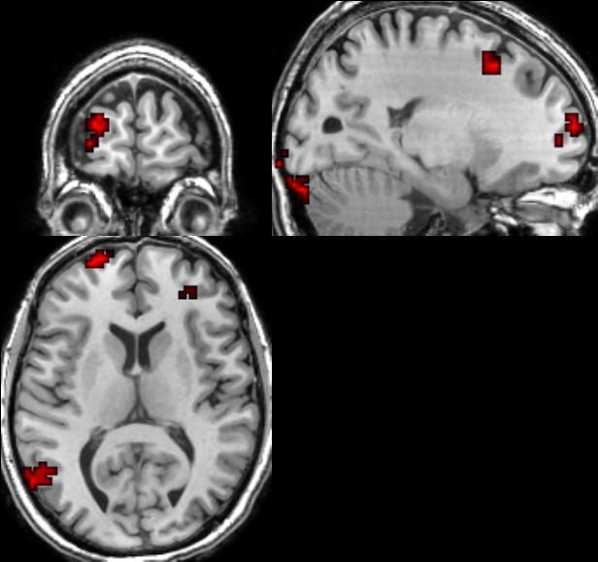
One example – Bic #264
Size=780 voxels
Detected in time window 114-123
Mean pairwise correlation = 0.763
Mean pairwise correlation (all TRs) = 0.41

Slide 22
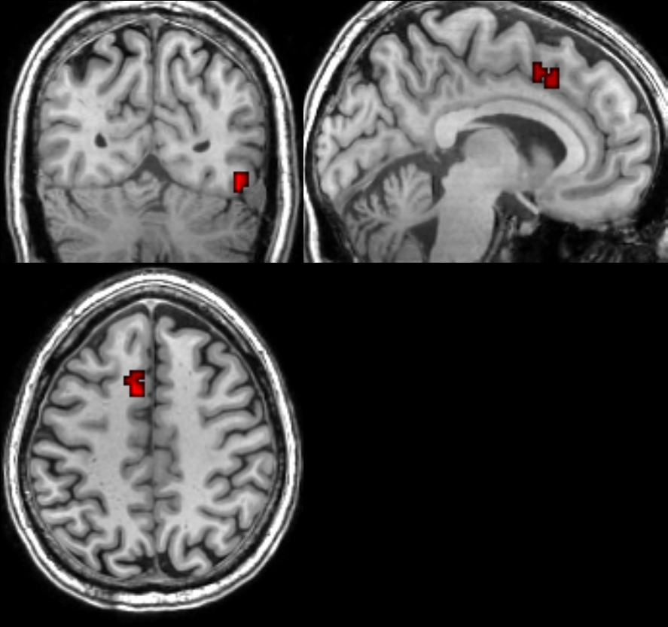
Another example– Bic #646
Size=38 voxels (two regions)
Detected in time window 90-105
Mean pairwise correlation = 0.74
Mean pairwise correlation (all TRs) = 0.44

Slide 23
Another example- Bic 358
Size=41 voxels (two regions)
Detected in time window 12-24, 36-45
Mean pairwise correlation = 0.76
Mean pairwise correlation (all TRs) = 0.43

Slide 24
So what do we get?
A few hundreds ConBics
For each one we have: - Size (2D) - Mean pairwise homogeneity (in time win) - Mean pairwise homogeneity (Entire time) - Clustering coefficient

Slide 25
How can we evaluate a single bic?
Anatomic labeling of the voxels in each bic
Number of separate areas (we are searching for networks)
Bi-laterality
Number of TRs
Significance of homogeneity (how? Random data? Scores of random bic?)
Cross subjects repetitions
Other suggestions….

Slide 26
How can we evaluate a solution?
Need a scoring scheme
Average scores
Best scoring networks
Spatial comparisons
Redundancy
Findings that can be verified by other methods or literature

Slide 27
ConBic results size
Top 5% removed for better plot resolution

Slide 28
Selected ICA clusters according to our evaluation

Slide 29
Comparison on one dataset
Resting state data – 5 min of rest
Method | # networks | #voxels | Mean pairwise corr | Redund | % linked voxels | Clustering coefficient
ICA positive | 36 | 30-400 (185) | 0.075-0.55 (0.223) | 0 | 72-99 (94.8) | 0.02-0.13 (0.0524)
ICA negative | 36 | 3-190 (54) | 0.03-0.44 (0.156) | 0 | 40-100 (86) | 0.02-0.33 (0.092)
Con Clust | 30 | 30-3519 (449) | 0.58-0.752 (0.645) | 0 | 100 | 0.003-0.32 (0.116)
ConBic | 791 | 11-15,000 (483) | 0.14-0.92 (0.53) | 0 | 100 | 0.0001-0.78 (0.154)
* ICA currently performed using GroupICAT v2.0e
Notes:
We use prior knowledge: gray matter mask, spatial structure
Redundancy=over 0.6 jaccard

